Slide 1
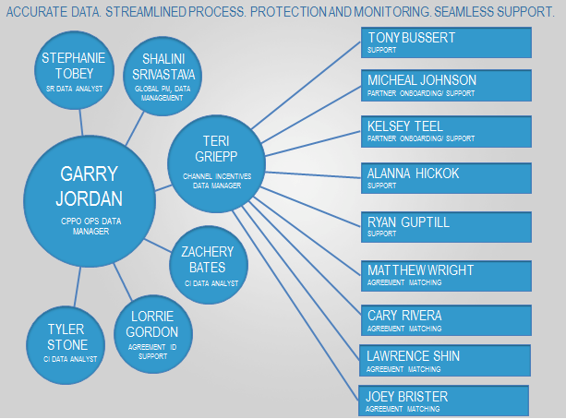
Microsoft Channel Incentives Support
The Challenge
Microsoft WWPG needed outstanding employees to manage onboarding and support for tens of thousands of Microsoft Partners. Affirma was engaged to help solve this unique challenge by recruiting and hiring the best available talent for this project.
What We Did
The Channel Incentives Support team works in a very dynamic and challenging environment to deliver excellent support to the Worldwide Partner Group at Microsoft. This team continues to manage on boarding and support for tens of thousands of Microsoft Partners in FY13.
Results
The Channel Incentives Support Team has received kudos from the Vice President of Operations at Microsoft for their fantastic work.

